Slide 1
8-X Environment Command Line Arguments

Slide 2
User and Group ID
Material from Chapter 8, Users and Groups
Material from Chapter 9, Process Credentials
Material from Chapter 15, File Attributes

Slide 3
User and Group ID
GID – Real Group ID.
Users can belong to one or more groups.
UID – Real User ID.
Identifies the user who is responsible for the running
process.
EGID – Effective Group ID. The ID that matters.
EUID - Effective User ID. The ID that matters.
A user with effective user ID of zero has all the privileges of the superuser.
It is called a privileged process.
Notes:
Page 167

Slide 4
Real ID Functions
pid_t getuid(void);
Returns the real user ID of the current process
pid_t geteuid(void);
Returns the effective user ID of the current process
gid_t getgid(void);
Returns the real group ID of the current process
gid_t getegid(void);
Returns the effective group ID of the current process

Slide 5
Change UID and GID (1)
#include <unistd.h>
#include <sys/types.h>
int setuid( uid_t uid )
int setgid( gid_t gid )
Sets the effective user ID of the current process.
Superuser process resets the real effective user IDs to uid.
Non-superuser process can set effective user ID to uid,
only when uid equals real user ID or the saved set-user ID
(set by executing a setuid-program in exec).
In any other cases, setuid returns error.

Slide 6
Environment file

Slide 7
Environment
extern char **environ;
int main( int argc, char *argv[ ], char *envp[ ] )
environment
pointer
environment
list
environment
strings
environ:
HOME=/home/stevens\0
PATH=:/bin:/usr/bin\0
SHELL=/bin/sh\0
USER=stevens\0
LOGNAME=stevens\0
NULL
Notes:
// pointer to a bunch of pointers. Array of strings.

Slide 8
Example: environ
#include <stdio.h>
void main( int argc, char *argv[], char *envp[] )
{
int i;
extern char **environ;
printf( “from argument envp\n” );
for( i = 0; envp[i]; i++ )
puts( envp[i] );
printf(“=================================“);
printf(“\nFrom global variable environ\n”);
for( i = 0; environ[i]; i++ )
puts(environ[i]);
}
Notes:
csc60/ClassExamples/environ.c

Slide 9
#include <stdlib.h> (Page 127)
char *getenv(const char *name);
Returns pointer to (value) string, or NULL if no such variable
Retrieves individual values from the process environment.
Searches the environment list for a string that matches the string pointed to by name.

Slide 10
#include <stdlib.h> (Page 128)
int putenv(char *string);
Returns 0 on success, or nonzero on error
Adds or changes the value of the calling process’s environment variables.
The argument string is of the form name=value.
If name does not already exist in the environment, then string is added to the environment.
If name does exist, then the value of name in the environment is changed to value.

Slide 11
Example : getenv, putenv
#include <stdio.h>
#include <stdlib.h>
void main(void)
{
printf(“Home directory is %s\n”, getenv(“HOME”));
putenv(“HOME=/”);
printf(“New home directory is %s\n”, getenv(“HOME”));
}
Notes:
Class files = getenv_putenv.c

Slide 12
Linux Scheduling

Slide 13
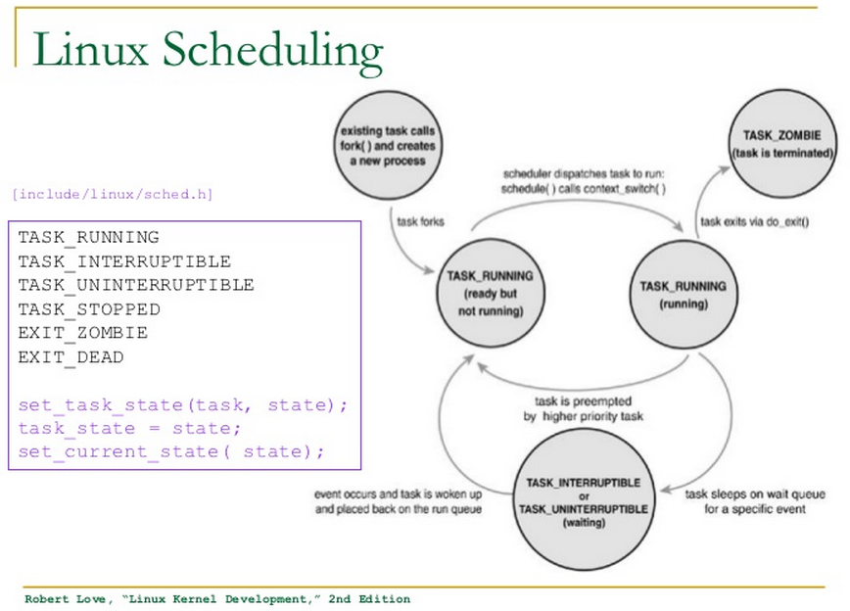
Re-typed on next two slides.

Slide 14
This slide shows the contents of the box on the previous slide.
(include/linux/sched.h)
TASK_RUNNING
TASK_INTERRUPTIBLE
TASK_UNINTERRUPTIBLE
TASK_STOPPED
EXIT_ZOMBIE
EXIT_DEAD
set_task_state(task, state);
task_state = state;
set_current_state ( state );

Slide 15
Linux Scheduling
Existing task calls
fork( ) and creates a new process task
TASK_ZOMBIE
(task is terminated)
task forks
scheduler dispatches task to run;
schedule( ) calls context_switch( )
task exits via do_exit( )
TASK_RUNNING
(ready but not running)
TASK RUNNING
(running)
event occurs &
task is awoken &
placed back on the run queue
task is preempted
by higher priority task
Task sleep on wait
Queue For a specific event
TASK_INTERRUPTIBLE
or
TASK_UNINTERRUPTIBLE
(waiting)

Slide 16
The ps command in Linux
ps - report a snapshot of the current processes.
There are many flags and options available.
By default, the simple ps command will show only your own processes.

Slide 17
Process State Codes (from ps command)
PROCESS STATE CODES
Here are the different values that the s, stat and state output
specifiers (header "STAT" or "S") will display to describe the state of
a process.
D Uninterruptible sleep (usually IO)
R Running or runnable (on run queue)
S Interruptible sleep (waiting for an event to complete)
T Stopped, either by a job control signal or because it is being
traced.
W paging (not valid since the 2.6.xx kernel)
X dead (should never be seen)
Z Defunct ("zombie") process, terminated but not reaped by its
parent.

Slide 18
Process State Codes (from ps command)
For BSD formats and when the stat keyword is used, additional
characters may be displayed:
< high-priority (not nice to other users)
N low-priority (nice to other users)
L has pages locked into memory (for real-time and
custom IO)
s is a session leader
l is multi-threaded (using CLONE_THREAD,
like NPTL pthreads do)
+ is in the foreground process group

Slide 19
Command Line arguments

Slide 20
Command line arguments - Format
Command line arguments are extra options that a user can pass to a program that is started from the command line.
Format: exec_filename arg1 arg2 arg3 …
Arguments are listed after the executable name.
Arguments are separated with whitespace.

Slide 21
Command line arguments - Declaration
By modifying the main() function header, a C program can access command line arguments.
Change this:
int main (void)
To this:
int main (int argc, char * argv[])

Slide 22
Command line arguments – argc/argv parameters
main() function parameters:
argc holds the total number of command line arguments (implicit+explicit).
argv is an array of pointers to strings. Each argument value is stored as a string.
argv[0] contains the name of the executable.
Subsequent argv elements contain the explicit arguments (if any), in the order they appeared on the command line.
The final element in argv is always a NULL pointer.
A simple example will clarify this

Slide 23
argc/argv example 1
int main (int argc, char* argv[])
{
printf("%s %d %s \n", "You entered" , argc, "arguments");
printf("%s: %s\n" , "The zero arg. is the program name " , argv[0]);
printf("%s: %s\n" , "The first argument is" , argv[1]);
printf("%s: %s\n" , "The second argument is", argv[2]);
}
$ gcc argv_example.c –o argv_example
$ argv_example hello world
You entered 3 arguments
The zero arg. is the program name: argv_example
The first argument is: hello
The second argument is: world

Slide 24
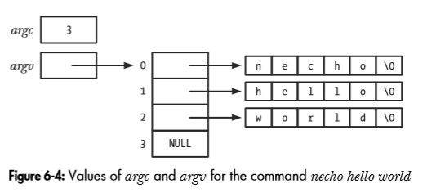
Example 2 – necho.c (from LPI, page 123)
$necho hello world
/* necho.c
A simple version of echo(1): echo our command-line arguments.
*/
#include "tlpi_hdr.h"
int
main(int argc, char *argv[])
{
int j;
for (j = 0; j < argc; j++)
printf("argv[%d] = %s\n", j, argv[j]);
exit(EXIT_SUCCESS);
}
argv[]

Slide 25
Example 3 – a compile line
> gcc lab7.c –o struc argc = 4
The Array | Contents
0 | gcc
1 | lab7.c
2 | -o
3 | struc

Slide 26
Example 4 – redirect output to a file
> struc > lab7.txt argc = 3
The Array | Contents
0 | struc
1 | >
2 | lab7.txt

Slide 27
Example 4 – redirect input & output
wc - print newline, word, and byte counts for each file
Create a file: ls > ls.txt
Get counts for this file: wc < ls.txt
Get counts for this file
Save counts in a file: wc < ls.txt > wc.txt

Slide 28
Example 4 – redirect input & output
ls > ls.txt argc = 3
wc < ls.txt > wc.txt argc = 5
wc < ls.txt argc = 3
The Array | Contents
0 | ls
1 | >
2 | ls.txt
The Array | Contents
0 | wc
1 | <
2 | ls.txt
3 | >
4 | wc.txt
The Array | Contents
0 | wc
1 | <
2 | ls.txt

Slide 29
8-X Environment Command Line Arguments
The End

